Slide 1
PWM DRAWER AMIT GRADUATION PROJECT
BY : Omar Khalid Ahmed
Omar162094@bue.edu.eg
Group : D47

Slide 2
TABLE OF CONTENTS
01
02
03
04
Introduction
Project Configuration
Modularity
Display Mode
03
Flow Chart
04
Conclusion

Slide 3
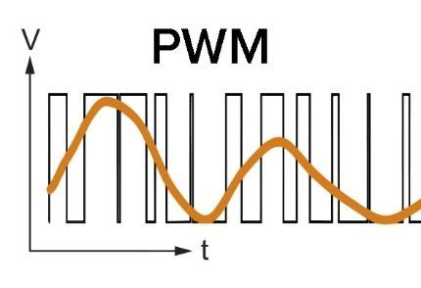
Introduction
Pulse width modulation is a powerful
approach for controlling semiconductor devices. PWM, or pulse width modulation, is a typical control technique for generating analogue signals from digital devices such as microcontrollers. The resulting signal will comprise a train of pulses that are in the shape of square waves. As a result,
the wave will be either high or low at any given time. In this project, PWM is utilized in a more straightforward manner to adjust the effective voltage applied to an external module.

Slide 4
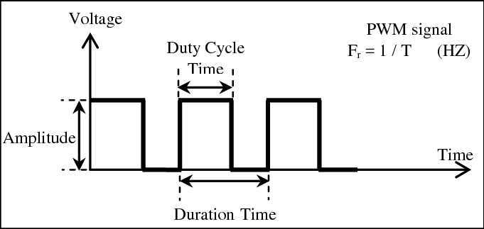
Introduction
The duty cycle is simply how much of the overall pulse time is taken up by the ON time.
Duty Cycle = On Time / Total Period
Frequency = 1/ Total Period

Slide 5

02
Project Configuration

Slide 6
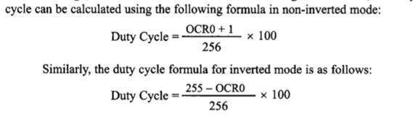
PD7 is the output pin (internal PWM output):
- Using PWM Driver
- Fast PWM , non-inverting mode
- No prescaling ( PWM_NO_Prescaling)

Slide 7
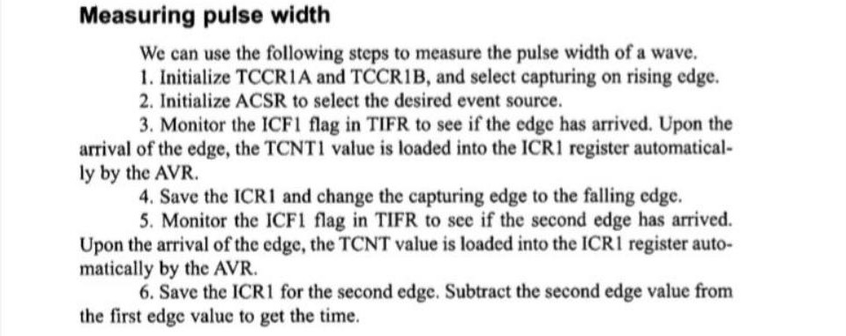
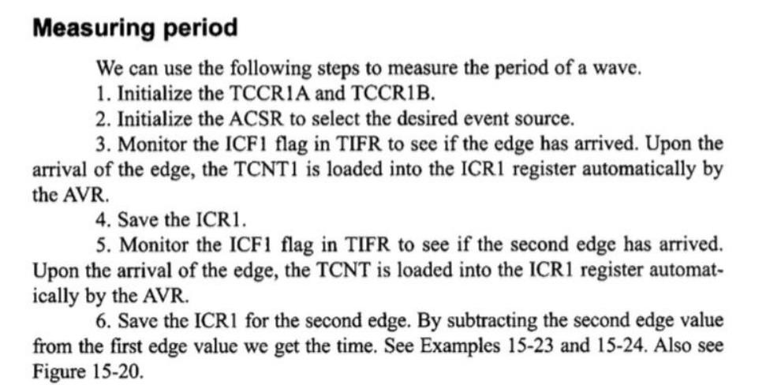
PD6 is the input pin (PWM reading pin):
- TIMER1 (ICU Driver)
- Measuring with Input capture unit (ICU)

Slide 8

03
Modularity

Slide 9
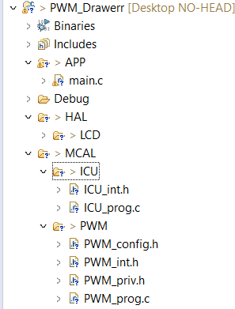
Application
main.c
HAL
LCD (16x2) module
MCAL
PWM (TIMER2 peripheral)
ICU ( TIMER1 peripheral)

Slide 10
04
Display Mode

Slide 11
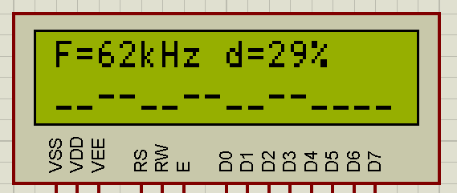
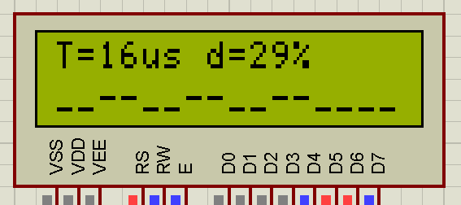
Because the frequency and period may be readily retrieved from one another using (f = 1/T), a DISPLAY macro is utilized If set to FREQ (the default),
the LCD will display the frequency and duty cycle along with the waveform.
If it is set to TIME , the LCD will display the period instead of the frequency and the other characteristics as usual

Slide 12
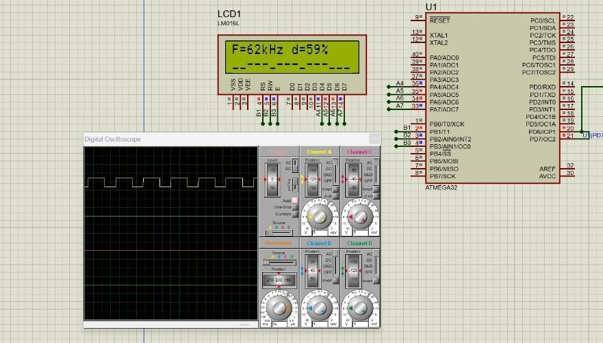

Slide 13
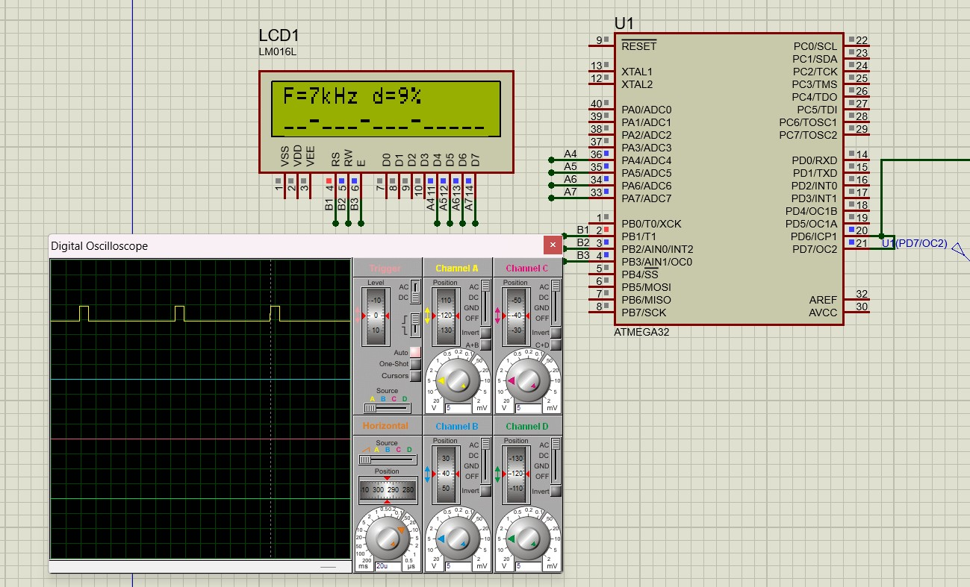

Slide 14
05
Flow Chart

Slide 15
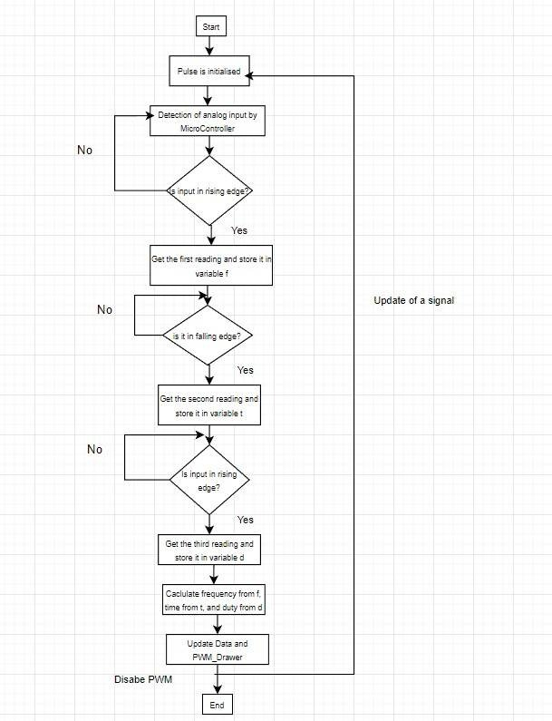
This Flow Chart Describes the algorithm of the ICU and How it measures the PWM generated Signal

Slide 16
Conclusion
The aim of this project is to create an Oscilloscope in a LCD. Visualizing a duty cycle on a 16x2 LCD with a range of 10.

Slide 17
THANKS!
DO YOU HAVE ANY QUESTIONS?

